Slide 1
Print Advertising
Climate Change and Sustainability
Instructions:
Below is an advertisement on sustainability and climate change.
Your task is to use this advertisement for your Advertisement Analysis Retrieval Assessment.

Slide 2
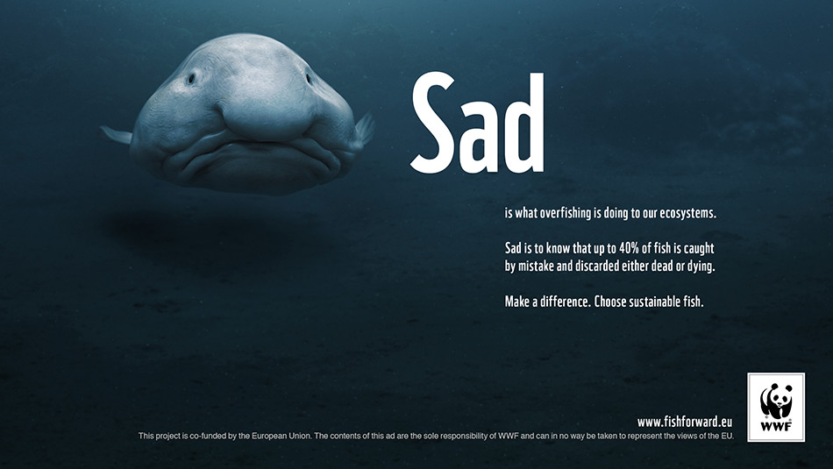

Slide 3
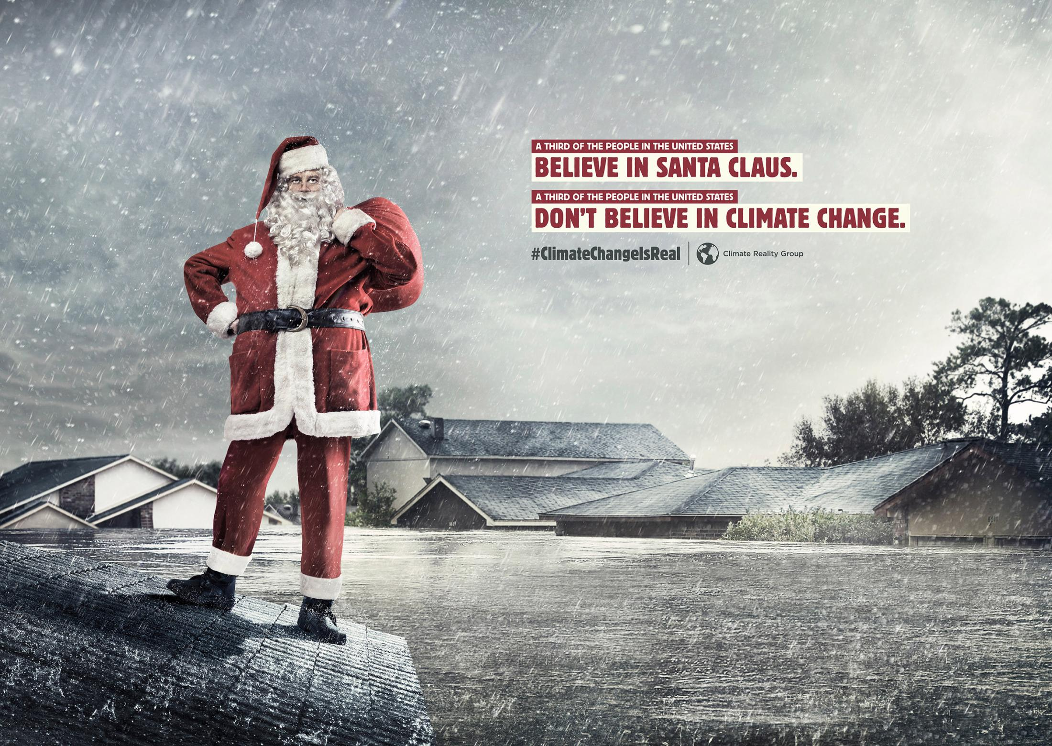

Slide 4
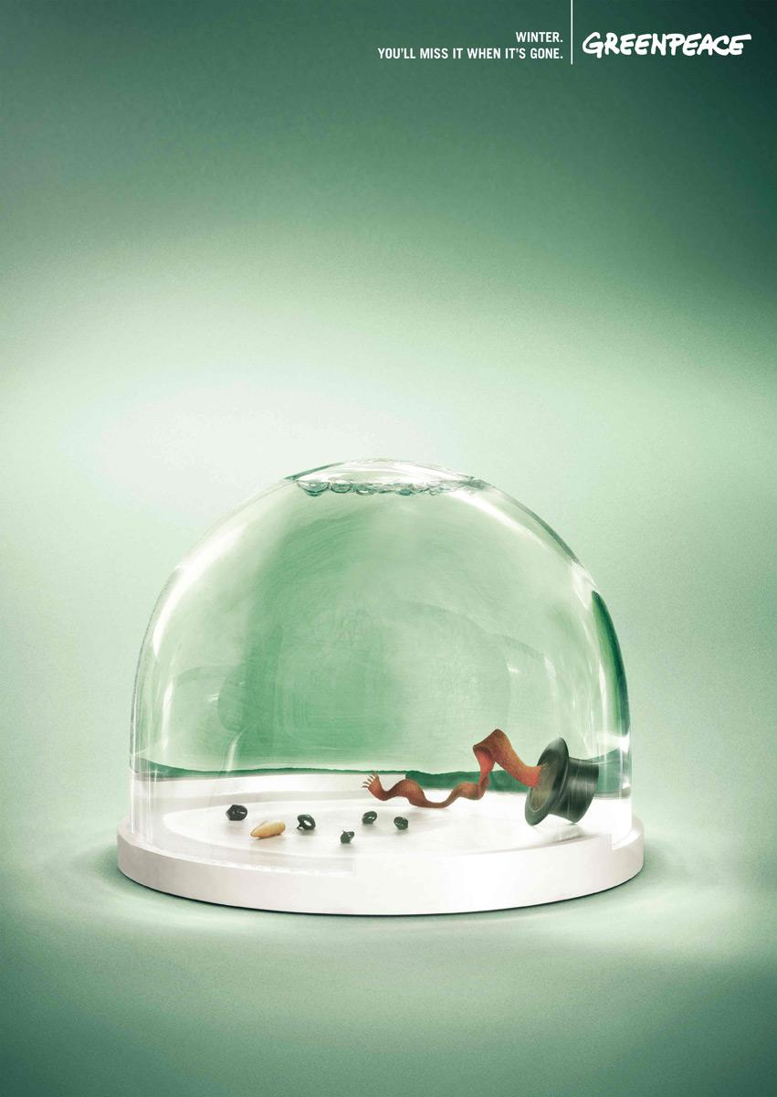

Slide 5
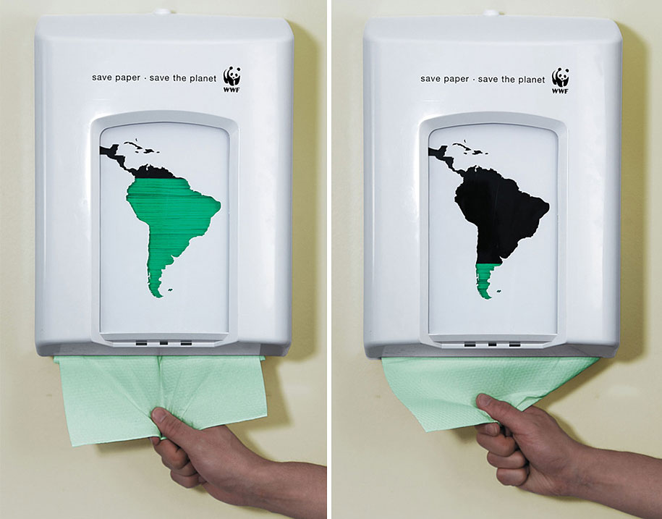

Slide 6
